Slide 1
Organizational Influences & Project Life Cycle
Week 2→ Lecture 3&4
By
Humaira Afzal
Lecturer CS, CUI Lahore Campus

Slide 2
THE ENVIRONMENT IN WHICH PROJECTS OPERATE
Projects exist and operate in environments that may have an inﬂuence on them. These inﬂuences can have a favorable or unfavorable impact on the project.
Two major categories of inﬂuences are
Enterprise Environmental Factors (EEFs)
Organizational Process Assets (OPAs)

Slide 3
Enterprise Environmental Factors (EEFs)
Enterprise environmental factors (EEFs) refer to conditions, not under the control of the project team, that inﬂuence, constrain, or direct the project.
EEFs are considered as inputs to many project management processes, speciﬁcally for most planning processes.
In addition, these factors may have a positive or negative inﬂuence on the outcome.
These conditions can be internal and/or external to the organization.

Slide 4
Enterprise Environmental Factors (EEFs)
EEFS INTERNAL TO THE ORGANIZATION
The following EEFs are internal to the organization:
- Organizational culture, structure, and governance.
Examples include vision, mission, values, beliefs, cultural norms, leadership style, hierarchy and authority relationships, organizational style, ethics, and code of conduct.
- Geographic distribution of facilities and resources.
Examples include factory locations, virtual teams, and cloud computing.

Slide 5
Enterprise Environmental Factors (EEFs)
Infrastructure. Examples include existing facilities, equipment, organizational telecommunications channels…..
Information technology software. Examples include scheduling software tools, conﬁguration management systems…
Resource availability. Examples include contracting and approved providers and subcontractors, and collaboration agreements.
Employee capability. Examples include existing human resources expertise, skills, competencies, and specialized knowledge.

Slide 6
Enterprise Environmental Factors (EEFs)
EEFS EXTERNAL TO THE ORGANIZATION:
The following EEFs are external to the organization.
Marketplace conditions. Examples include competitors information, Customer demand…
Social and cultural influences and issues. Examples include political climate, codes of conduct and ethics.
Legal restrictions. Examples include country or local laws and regulations related to security, data protection, business conduct, and employment
Physical environmental elements. Examples include working conditions, weather, and constraints.

Slide 7
Organizational Structure
A project operates within people, process and technology of an organization.
Organizational structure is an enterprise environmental factor, which can effect the availability of resources and influence how projects are conducted.
Organizational structure (OS) is the systematic arrangement of human resources in an organization. It outlines the roles and responsibilities of every member of the organization ..ensuring the smooth functioning of organization.

Slide 8
Organizational Structures
Different types of organizational structures include:
Functional
Projectized
Matrix
Weak matrix
Balanced matrix
Strong matrix

Slide 9
Organizational Structures
Functional :
This is the most common form of an organization. Organizational departments are grouped by areas of specialization within different functions.
Organization separated into departments according to each department respective functions. Example ..Accounting department, Marketing department,Sales,Production unit…
Each department there is a departmental manager. All of the manager work for CEO.
In this structure, employees of each department only communicate with one another and their leaders. Generally, the heads of these specialized units will report to the top management of the company.

Slide 10
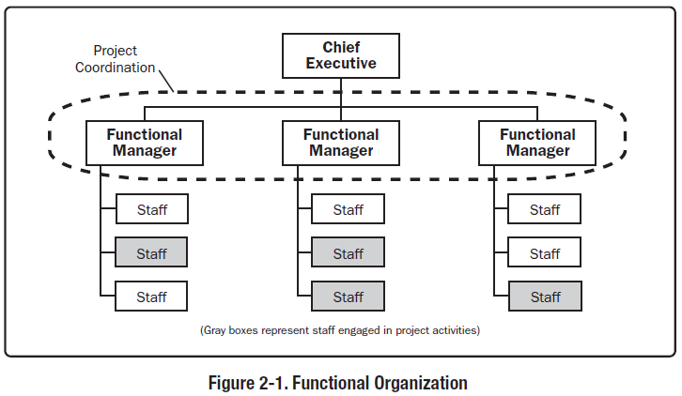
Functional Organization
.

Slide 11
Advantages/Disadvantages
Functional Organization
Grouped by areas of specialization/ functions.
Advantages:
It allows employees to develop their individual skills rapidly, Employees having one supervisor with a clear chain of command, Stable organization Structure and easy to design.
Disadvantages: Lack of communication among members of team, Multiple projects compete for limited resources, PM has little or no authority.

Slide 12
Organizational Structures
Projectized :
Organization is by projects. an organizational structure that focuses on projects, its process, as well as the tasks within it.
The company will be separated into different project teams. The Project Manager has authority to control his/her projects.
The team members only work for their project managers. They are independent from other projects.
Many IT companies use this structure.

Slide 13
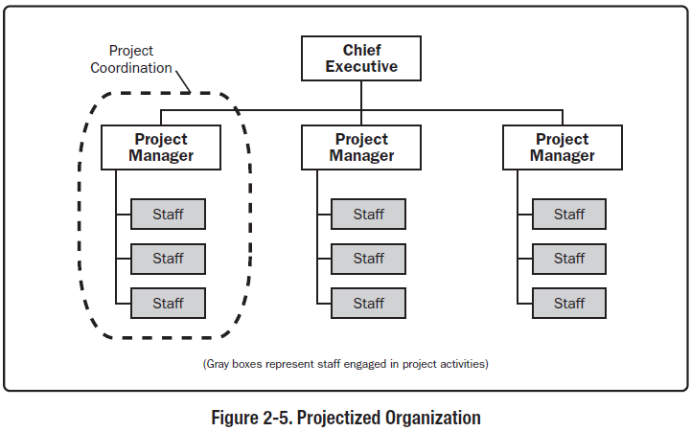
Projectized Organization

Slide 14
Advantages/Disadvantages
Projectized Organization
Organization is by projects. Personnel report to PM/has total power.
Advantages: Efficient project organization - loyalty to the project - effective communications.
Disadvantages: Absolute authority can make project managers arrogant.
The cost of employees and equipment can be higher because they are being hired for a shorter period. Moreover, this cost can become much higher if the project is delayed.

Slide 15
Matrix Organizational Structures
The matrix organizational structure is a combination of two or more different kinds of organizational structures, such as project management or functional management.
The matrix structure is composed of both a traditional hierarchy of management, where employees are managed by a functional manager, as well as additional project managers who can manage employees across different departments.

Slide 16
Matrix Organizational Structures (Cont.)
This type of structure is often useful when skills need to be shared across departments to complete a task and can allow companies to utilize a wide range of talents and strengths.
There are three types of matrix organizational structures:
Weak Matrix Organizational Structures
Balanced Matrix Organizational Structures
Strong Matrix Organizational Structures

Slide 17
Matrix Organizational Structures (Cont.)
A weak matrix structure is most similar to a traditional hierarchical structured workplace.
A functional manager is the dominant decision-maker and oversees all aspects of a project.
The project manager is in a position of authority but ultimately reports to the functional manager.
As an employee in this structure, you work under both the functional and project manager's guidance and direction. However, your main direction comes from your functional manager.

Slide 18
Matrix Organizational Structures (Cont.)
A balanced matrix structure gives more authority to the project manager than within a weak matrix structure.
Both the functional and project managers hold authority.
As an employee in this structure, you work under the guidance and direction of both managers. Your functional manager is your primary contact, but you still report to the project manager.

Slide 19
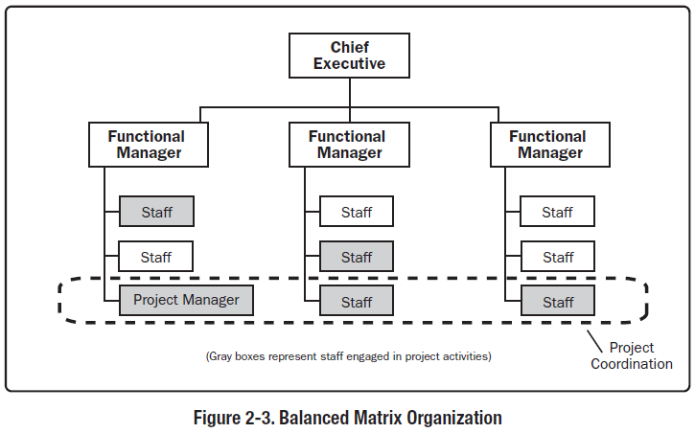
Balanced Matrix Organization

Slide 20
Matrix Organizational Structures (Cont.)
A strong matrix structure gives the project manager equal or greater authority than a functional manager.
The project manager has primary control over resources and the distribution of tasks.
As an employee in this structure, your primary direction and guidance come from the project manager, with secondary direction coming from the functional manager.

Slide 21
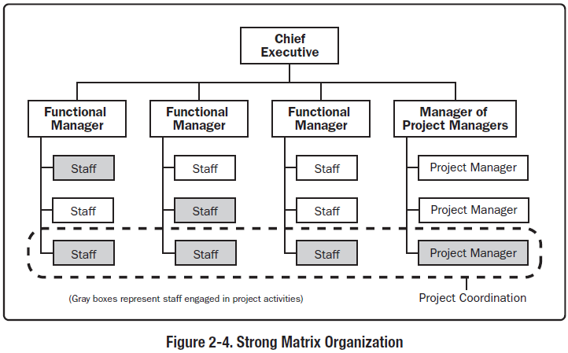
Strong Matrix Organization

Slide 22
Advantages/Disadvantages
Matrix Organization
Power varies between project & functional managers according to its type (strong, balanced or weak)
Advantages:
Improved communication …
Encouraging professional development.

Slide 23
Advantages/Disadvantages
Matrix Organization
Disadvantages:
Different priorities between PM & FM (conflicts)
Dual reporting
Complex to monitor and control

Slide 24
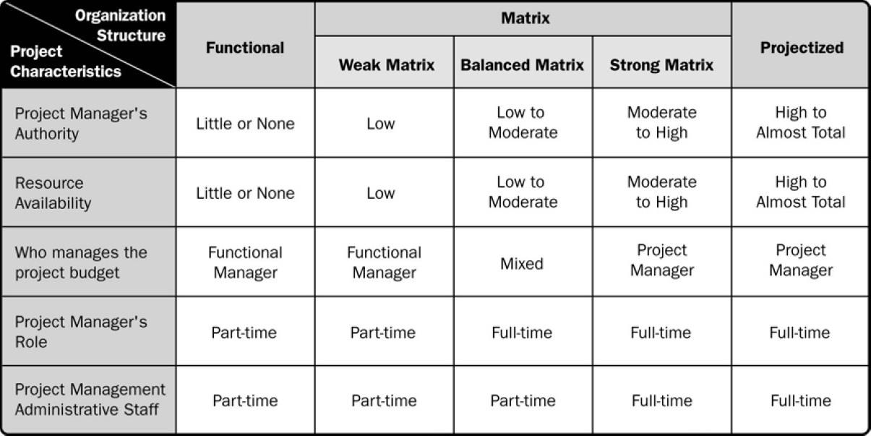
.
Organizational Structure Influences on Projects

Slide 25
FACTORS IN ORGANIZATION STRUCTURE SELECTION
Factors to consider in selecting an organizational structure.
Degree of alignment with organizational objectives
Specialization capabilities
Clear line and scope of authority
Responsibility assignment
Cost considerations
Physical locations (e.g. Regional, virtual)

Slide 26
Practice
You are working as a project manager in a company. You have the highest degree of authority; you are working full-time on your project, and you manage the project's budget. What is the organizational structure of your company?
Projectized
Functional
Balanced Matrix
A project manager is trying to complete a software development project but cannot get enough attention for the project. Resources are focused on completing process-related works and the project manager has little authority to properly assign resources. What form of organization must the project manager be working in?
A balanced matrix
A functional organization
Projectized
A strong matrix

Slide 27
ORGANIZATIONAL PROCESS ASSETS
Organizational process assets (OPAs) are the plans, processes, policies, procedures, and knowledge bases speciﬁc to and used by the performing organization. These assets inﬂuence the management of the project.
They may be grouped into two categories:
Processes, policies, and procedures(established by PMO office)
Organizational knowledge bases (updated throughout the project)
-- Inputs to many processes

Slide 28
ORGANIZATIONAL PROCESS ASSETS
PROCESSES, POLICIES, AND PROCEDURES
The organization’s processes and procedures for conducting project work include but are not limited to:
Initiating and Planning:
Speciﬁc organizational standards such as policies (e.g., human resources policies, health and safety policies, security and conﬁdentiality policies, quality policies, and environmental policies)
project management methods, estimation metrics, process audits…
Organizational Templates (e.g., project management plans, project documents, project registers, report formats, contract templates…)

Slide 29
ORGANIZATIONAL PROCESS ASSETS
Executing, Monitoring, and Controlling:
Change control procedures including the steps by which performing organization standards, policies, plans, and procedures or any project documents will be modiﬁed, and how any changes will be approved and validated;
Closing. Project closure guidelines or requirements (e.g., ﬁnal project audits, project evaluations, deliverable acceptance, contract closure….

Slide 30
ORGANIZATIONAL PROCESS ASSETS
ORGANIZATIONAL KNOWLEDGE REPOSITORIES
Conﬁguration management knowledge repositories containing the versions of software and hardware components and baselines of all performing organization standards, policies, procedures, and any project documents
Financial data repositories containing information such as labor hours, incurred costs, budgets, and any project cost overruns
Historical information and lessons learned knowledge repositories.
Project ﬁles from previous projects (e.g., scope, cost, schedule, and performance measurement baselines, project calendars, project schedule network diagrams, risk registers, risk reports, and stakeholder registers).

Slide 31
PROJECT MANAGEMENT OFFICE
A project management office (PMO) is an organizational structure that standardizes the project-related governance processes and facilitates the sharing of resources, methodologies, tools, and techniques.
The responsibilities of a PMO can range from providing project management support functions to the direct management of one or more projects.
Notes:
Within an organisation, a Project Management Office (PMO) is a department that maintains project management standards. It helps project managers find the proper methods, processes, procedures, formats, templates, and information systems.

Slide 32
PROJECT MANAGEMENT OFFICE
There are several types of PMOs in organizations. Each type varies in the degree of control and inﬂuence it has on projects within the organization, such as:
Supportive. Supportive PMOs provide a consultative role to projects by supplying templates, best practices, training, access to information, and lessons learned from other projects.
This type of PMO serves as a project repository. The degree of control provided by the PMO is low.
.

Slide 33
PROJECT MANAGEMENT OFFICE
Controlling. Controlling PMO checks if the project management tools, processes, and standards are being applied in the projects, with some degree of control.
Directive. Directive PMOs take control of the projects by directly managing the projects. Project managers are assigned by and report to the PMO. The degree of control provided by the PMO is high.

Slide 34
PROJECT MANAGEMENT OFFICE
A primary function of a PMO is to support project managers in a variety of ways, which may include but are not limited to:
Managing shared resources across all projects administered by the PMO
Identifying and developing project management methodology, best practices, and standards.
Coaching, mentoring, training.
Monitoring compliance with project management standards, policies, procedures, and templates through project audits
Developing and managing project policies, procedures, templates, and other shared documentation (organizational process assets)
Coordinating communication across projects.

Slide 35
Project Team Composition
A project team includes the project manager and the group of individuals who act together in performing the work of the project to achieve its objectives.
The Project team includes the project manager, project management staff, and other team members who carry out the work but who are not necessarily involved with management of the project.
Project team composition refers to the structure of the team and how team members are brought together or combined into the team.

Slide 36
Project Team Composition
Basic Project team compositions
Dedicated: Work full time on the project.
Part-time: Some projects are established as temporary additional work.
For example, they may be a dedicated team where most of the project team members are assigned to work on the project full-time, or they may be part-time team members working on a project in addition to their regular work.

Slide 37
Project Team Composition
The structure and composition of a project team are influenced by various factors. Here are some key elements to consider in project team composition:
Project Manager: The project manager is responsible for overall project success, planning, execution, and communication with stakeholders. They may be a dedicated project manager or a functional manager taking on a temporary project management role.
Project Management Staff: This includes individuals responsible for specific aspects of project management, such as scheduling, budgeting, risk management, and administrative support.
Project management team members support the project manager in coordinating and controlling project activities.

Slide 38
Project Team Composition
Team members/ Project staff are individuals who contribute directly to project deliverables.
Team members may be full-time or part-time, depending on the project’s size and complexity.
External Stakeholders: In some cases, external stakeholders, such as vendors, consultants, or clients, may be part of the project team.

Slide 39
Project Team Composition
Skill Sets and Knowledge: The composition of the team should cover the entire skill spectrum required for project success.
Organizational Culture and Location: Organizational culture and location can influence how teams are structured and how they collaborate.
Temporary or Matrix Structures: Project teams can be organized as temporary entities for the duration of the project. Matrix structures involve team members reporting to both functional and project managers.

Slide 40
Project Team Composition
1. Appoint a Leader and the Initial Team and Sketch Out Project.
Bring together the people who are charged with initiating the project.
Sketch out the scope of the project, targets, what the key threats might be, what strategies you might undertake, and most importantly, who the key stakeholders might be.
This rough sketch gives you some idea of what skills and organizations you might need to involve in various roles on the project team.
2. Select Project Team Members based on the initial analysis.
3. Define Roles and Team Operations

Slide 41
Reading Assignment
Chapter 2: The Environment in which the Project Operates & Role of Project Manager by PMBOK-Guide-6th-Edition-PMI
(Book and Lecture Slides are already uploaded on the resource link.)

Slide 42
Home Task:
Search software organization and analyze the impact of organizational culture and structure on project management.

Slide 43
Thank You

